Slide 1
Introduction to Future Technology Transformations FTT(1)
Pim Vercoulen
p.vercoulen@student.ru.nl
May 19th, 2018 ASSIA office Nagoya University 名護多大学

Slide 2
Background
Framework developed by Jean-François Mercure (currently professor at Radboud University, Nijmegen, The Netherlands).
FTT:Power (2012, Jean-François Mercure) ← We’ll work with this model
FTT:Transport (2015, Aileen Lam)
FTT:Heat (2017, Florian Knobloch)
FTT:Steel (~2018, Lorena van Duuren & Pim Vercoulen) ← More on this later
FTT:Agriculture (~2018, Sören Linder)
FTT:Cement (t.b.a.)
Innovation economics
Bottom-up approach

Slide 3
Application of FTT (coupled to E3ME)
Fuelling Europe’s Future: How the transition from oil strengthens the economy (FTT:Transport)
Analysis of tariffs on solar panels from the Trump administration (FTT:Power)
Work done for the European Union:
Case study on R&D and spillovers on clean energy technologies(FTT:Power)
Case study on assessing the impacts of selected EU policies promoting clean energy finance (FTT:Power)
Report on a simulation model for technological change in the residential heating sector (FTT:Heat)
Work currently being done for India
Contributions to “Renewable Electricity Roadmap 2030 for India” (FTT:Power)

Slide 4
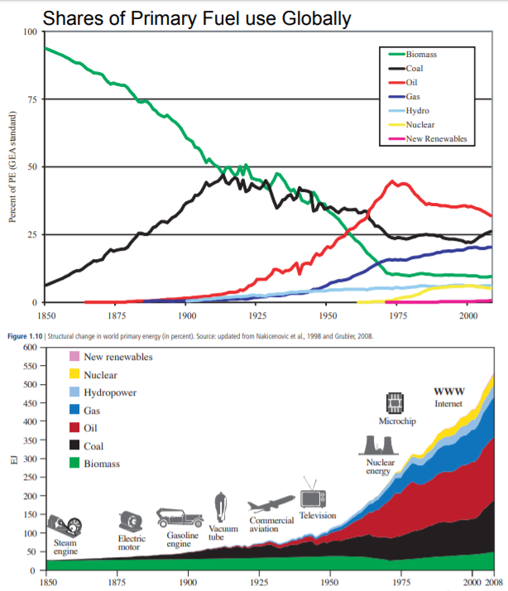
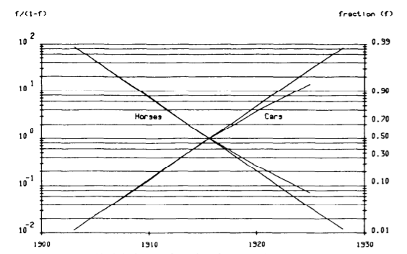
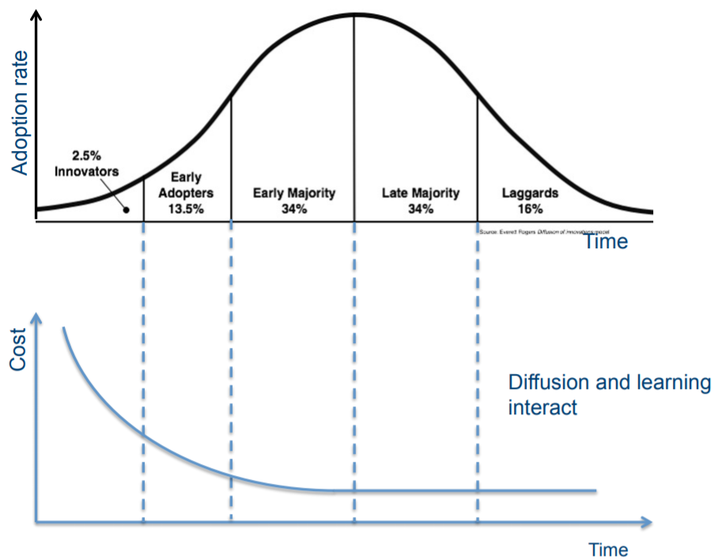
Innovation economics
FTT framework is based on innovation economics (=Schumpeter economics)
Learning rate
S-curve
Why innovation economics:
“Firstly, it is the application of technology that has caused the anthropogenic contribution to climate change in the historical context; both coal and oil were part of processes of transformations of economies and societies. Understanding the history of technology then helps us to direct the course of future technical change. Secondly, a change to a low carbon society will require widespread development and mass deployment of new, low carbon technologies”
(Köhler, et al. 2006)
The bottom-up schumpeter approach works well with the top-down post-Keynesian approach
Global Energy Assessment Ch1 Energy Primer p113 (2012)
Nakicenovic, Technology Forecasting and Social Change (1986)
E.M. Rogers, Diffusion of Innovations, Fifth Edition p281 (2010)

Slide 5
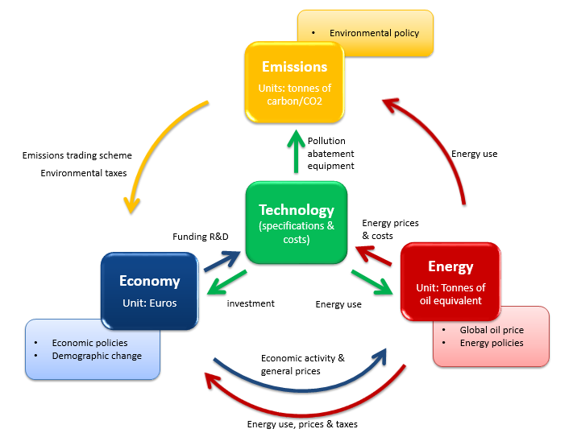
FTT-E3ME feedbacks
Post-Schumpeterian
(evolutionary)
FTT
・Fuel/Material consumption
・Investment in
new production technology
・product price
・product demand
・Fuel/Material demand
E3ME
Post-Keynesian
＝

Slide 6
General FTT Methodology – Levelized Cost
Price of commodity based on Levelised Cost calculation
$$NPVexpenses=\sum_{0}^{τ}{\frac{IC\left(t\right)+OM\left(t\right)+FC\left(t\right)+CO2T\left(t\right)+…}{{\left(1+r\right)}^{t}}}$$
${NPV}_{income}=$ $\sum_{0}^{τ}{\frac{P\left(t\right)∗Production(t)}{{\left(1+r\right)}^{t}}}=P∗\sum_{0}^{τ}{\frac{1}{{\left(1+r\right)}^{t}}}$
$$Break−even:\frac{{NPV}_{expenses}}{{NPV}_{income}}=\frac{\sum_{0}^{τ}{\frac{IC\left(t\right)+OM\left(t\right)+FC\left(t\right)+CO2T\left(t\right)+…}{{\left(1+r\right)}^{t}}}}{P∗\sum_{0}^{τ}{\frac{1}{{\left(1+r\right)}^{t}}}}=1$$
$LC\left(t\right)=P=$ $\frac{\sum_{0}^{τ}{\frac{IC\left(t\right)+OM\left(t\right)+FC\left(t\right)+CO2T\left(t\right)+…}{{\left(1+r\right)}^{t}}}}{\sum_{0}^{τ}{\frac{1}{{\left(1+r\right)}^{t}}}}$
$$sdLC=\frac{\sum_{0}^{τ}{\frac{\sqrt{{\left({sdIC}/{CF}\right)}^{2}+{sdOM}^{2}+{sdFC}^{2}+…}}{{\left(1+r\right)}^{t}}}}{\sum_{0}^{τ}{\frac{1}{{\left(1+r\right)}^{t}}}}$$
Costs are not perfectly defined since there are regional variances that can affect the costs as experienced by the investor

Slide 7
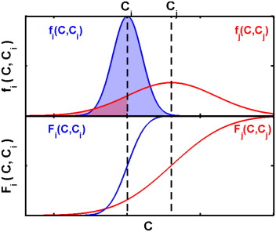
General FTT Methodology – Preference Matrix
Preference matrix
Probility of an investor chosing for technology i or j
Standard deviation of preference (dF_{ij})
${dF }_{ij}=\sqrt{2∗sd{{LC}_{i}}^{2}\text{∗} {{sdLC}_{j}}^{2}}$
Preference F_{A->B}
$F_{i→j}=\frac{1}{2}+\frac{1}{2}∗\frac{2}{\sqrt{π}}\int{e^{{−\left(\frac{{LCOS}_{j}−{LCOS}_{i}}{{sdF}_{ij}}\right)}^{2}}}$
$F_{j→i}={1−F}_{j→i}$

Slide 8
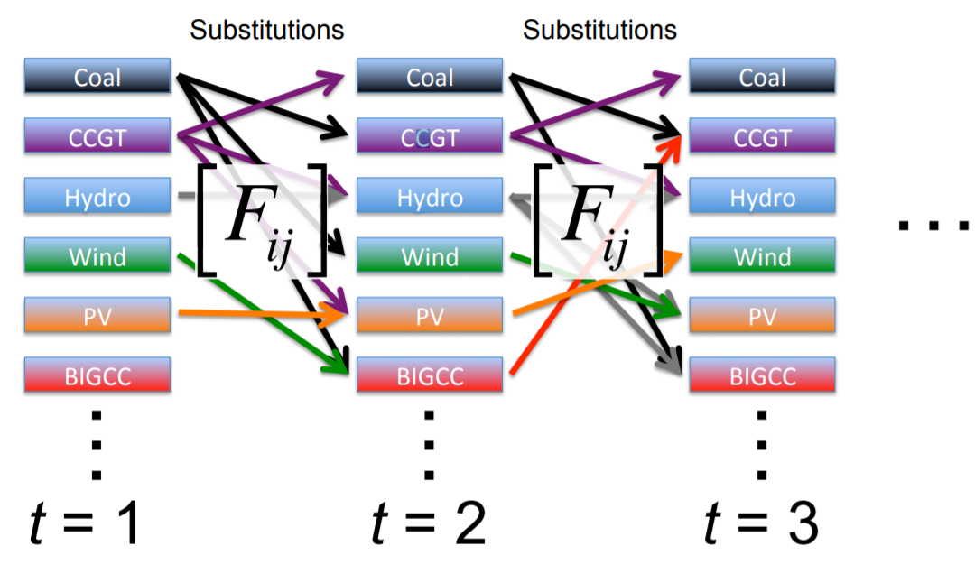
General FTT Methodology – Share changes
As a result of the LC, we get investor preferences (F_{ij}), and as a result of investor preferences we get market share changes (ΔS_{i->j})
$$∆S_{j→i}∝ \frac{S_{i}}{{BT}_{i}}∙\frac{S_{j}}{{LT}_{j}}∙F_{ij}∙∆t$$
$$∆S_{i→j}∝ \frac{S_{j}}{{BT}_{j}}∙\frac{S_{i}}{{LT}_{i}}∙F_{ji}∙∆t$$
$$\sum_{j}{∆S_{j→i}}={∆S}_{i}=\sum_{j}{S_{i}S_{j}∙\left(F_{ij}A_{ij}−F_{ji}A_{ji}\right)∙∆t}$$
$$A_{ij}= \frac{κ}{{BT}_{i}∙{LT}_{j}}$$

Slide 9
Policy instruments
Policies either affect the cost of production or regulate certain technologies and these will be replaced by other technologies
FTT:Power
Subsidy / tax on investment costs
Feed-in-tariff
Regulations
Exogenous share additions
Electricity demand management and storage
FTT:Transport
Vehicle taxes
Fuel taxes
Road taxes
Biofuel mandate
Registration carbon tax
Regulations
Exogenous vehicle additions
FTT:Heat
Subsidies
Feed-in-tariff
Fuel taxes
Access to finance
Exogenous share additions
Regulations
Heat demand management
FTT:Steel
Subsidy / tax on investment costs
Subsidy / tax on material costs
Regulations
Exogenous share additions
Demand and scrap availability management

Slide 10
FTT:Steel – Scope
A deep understanding of the sector is required
What is covered in the model:
Levelised cost of steelmaking (LCOS) is compared on the basis of crude steel production
Hot rolling
Input of raw materials
Coal
Natural gas
Electricity
Iron ore
Limestone
Biomass
Precursor steps:
Coking
Sintering
Pelletizing
Ironmaking
Blast furnace
Direct reduction
Smelt reduction
Hydrogen flash smelt
Steelmaking
Open hearth furnace
Basic oxygen furnace
Electric arc furnace
Molten oxide electrolysis
What else?:
The input of materials can vary (e.g. scrap input versus self-produced iron input)
Plant configurations can vary (e.g. size, efficiency, etc.)
Discrenpancies among sources
Crude steel
Cold rolling
Casting
Input of raw materials
Scrap

Slide 11
FTT:Steel – Data acquisition (work-in-progress)
Historical steel production is recorded by the World Steel Association (~1970-2017)
…but does not contain the resolution needed for this study
Historical emissions from the iron and steel industry are recorded by the Joint Research Centre of the European Commission (EC-JRC) (1970-2012)
…but only total emissions and not on technology-specific level
Material use was gathered from multiple sources and these show great variations
In different regions different material qualities are available
E.g. in Chinese reserves of iron ore and coal are usually of lower quality and therefore consume greater quantities
Material use over time changed, i.e. efficiency increased
…but no good source of historical material use was found

Slide 12
FTT:Steel – Data acquisition (work-in-progress)
Technology specific cost aspects varied accross sources
Investment costs of existing technologies were mainly obtained from IEA-ETSAP and IETD-IIP
Not on a regional basis due to limitation of sources and due to the assumption that it would vary little among countries since only a few engineering companies are available of steel plant construction
Operation and maintenance was made variable along with material consumption
Technological specifications of novel technologies
Based on scientific papers that serve as a proof of concept of technology, but how are costs estimated?

Slide 13
FTT:Steel – 26 technologies
Ironmaking |  | Steelmaking |  | Integrated route | Variations
Conventional Blast Furnace | + | Open Hearth Furnace | = | Conv. BF – OHF | Only fossil
Conventional Blast Furnace | + | Basic Oxygen Furnace | = | Conv. BF – BOF | Fossil Biomass Carbon Capture and Storage (CCS) Biomass + CCS
Blast Furnace Top Gas Recovery | + | Basic Oxygen Furnace | = | BF TGR – BOF | CCS Biomass + CCS
Gas-based Direct Reduction | + | Electric Arc Furnace | = | DRI-gas – EAF | Fossil Biomass CCS Biomass + CCS
Coal-based Direct Reduction | + | Electric Arc Furnace | = | DRI-coal – EAF | Fossil Biomass CCS Biomass + CCS
Smelt Reduction | + | Basic Oxygen Furnace | = | SRI – BOF | Fossil Biomass CCS Biomass + CCS
Advanced Smelt Reduction | + | Basic Oxygen Furnace | = | SRI+ - BOF | Fossil Biomass CCS Biomass + CCS
Hydrogen Flash Smelt | + | Electric Arc Furnace | = | HFS – EAF | No variations
- | + | Molten Oxide Electrolysis | = | MOE | No variations
- | + | Electric Arc Furnace | = | Scrap – EAF | No variations

Slide 14
FTT:Steel – Variable material input
 | Steelmaking technology | Ironmaking technoloy | Intermediate plants (coke plant, sinter plant, pellet plant) |  |  | Raw materials
 | Steel | Iron | Coke | Sinter | Pellets | Scrap | Coal | Natural Gas | Electricity | Iron ore | Limestone | Hydrogen | Biomass
Steel | … | … | … | … | … | … | … | … | … | … | … | … | …
Iron | … | … | … | … | … | … | … | … | … | … | … | … | …
Coke | … | … | … | … | … | … | … | … | … | … | … | … | …
Sinter | … | … | … | … | … | … | … | … | … | … | … | … | …
Pellets | … | … | … | … | … | … | … | … | … | … | … | … | …
Scrap | … | … | … | … | … | … | … | … | … | … | … | … | …
Coal | … | … | … | … | … | … | … | … | … | … | … | … | …
Natural Gas | … | … | … | … | … | … | … | … | … | … | … | … | …
Electricity | … | … | … | … | … | … | … | … | … | … | … | … | …
Iron ore | … | … | … | … | … | … | … | … | … | … | … | … | …
Limestone | … | … | … | … | … | … | … | … | … | … | … | … | …
Hydrogen | … | … | … | … | … | … | … | … | … | … | … | … | …
Biomass | … | … | … | … | … | … | … | … | … | … | … | … | …
Coal quality can affect the amount of coal and coke consumed
Iron ore quality (i.e. iron content) affects the amount of iron ore consumed
Scrap is usually co-melted for quality insurance and to suppress costs
…but scrap is not always available
…but scrap quality can vary (even to the point where it is rendered useless
How does FTT:Steel calculate material consumption for each time iteration?
Input-Output !
Identity matrix IO-table Final demand vector
$$Inventory={\left(\left(\begin{matrix}1 & ⋯ & 0 \\ ⋮ & ⋱ & ⋮ \\ 0 & ⋯ & 1\end{matrix}\right)−\left(\begin{matrix}X_{11} & ⋯ & X_{1n} \\ ⋮ & ⋱ & ⋮ \\ X_{n1} & ⋯ & X_{nn}\end{matrix}\right)\right)}^{−1}∗\left(\begin{matrix}1 \\ ⋮ \\ 0\end{matrix}\right)$$

Slide 15
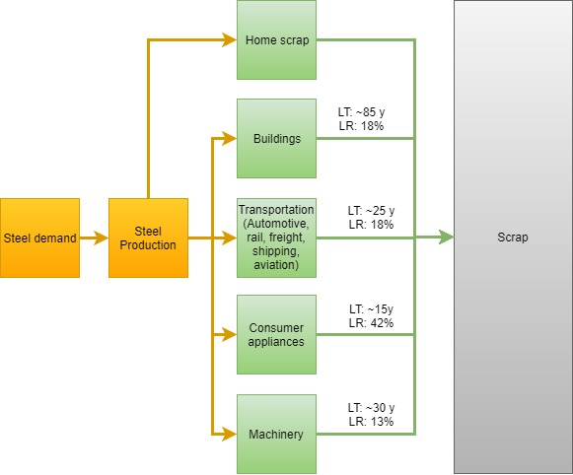
FTT:Steel – Scrap Availability
Scrap availability is proportional to steel stocks within different sectors
…but steel becomes available as scrap after the EOL
…and different sectors use different steel qualities and coatings which could render it unsuitable as steel scrap

Slide 16
FTT:Steel – Overall structure after coupling to E3ME

Slide 17
FTT:Steel – Description of the Chinese steel industry
Steel production in 2014:
93% through the BF-BOF route
7% through the Scrap-EAF route
It is probable that other technologies, such as DRI-EAF and SRI-BOF are present as well, but no quantitative sources
Scrap availability is limited in China
Policies in China
Steel industry (used to be) subsidised → Implementation in FTT?
Merging smaller companies into bigger ones, i.e. increasing efficiency
Low quality of coal and iron ore

Slide 18
FTT:Steel – Description of the Japanese steel industry
Steel production in 2014:
77% through the BF-BOF route
23% through the Scrap-EAF route
Corex (SRI-BOF) is used in Japan, but no quantitative data (yet)
No DRI-gas – EAF, because no natural gas
Scrap availability is sufficient to feed scrap-EAF route
Policies in Japan:
COURSE50

Slide 19
FTT:Steel – Description of the Korean steel industry
Steel production in 2014:
64% through the BF-BOF route
33% through the Scrap-EAF route
0,7% Corex (SRI-BOF) → limited data
1,4% Finex (SRI+ -BOF) → limited data
Scrap availability is sufficient to feed scrap-EAF route
Policies in Korea:
Considering to implement ETS

Slide 20
FTT:Steel – Description of the Taiwanese steel industry
Steel production in 2014:
59% through the BF-BOF route
41% through the Scrap-EAF route
Scrap availability is sufficient to feed scrap-EAF route
Policies in Taiwan:
Energy Tax Act (drafting)

Slide 21
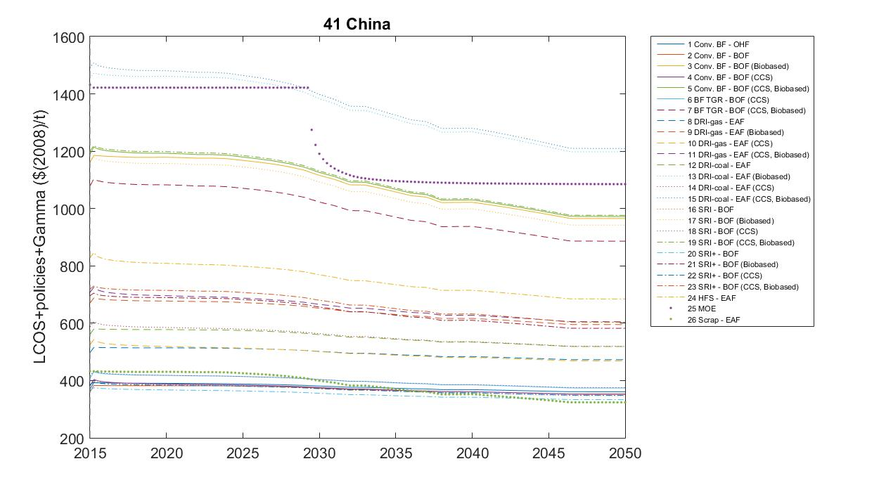
FTT:Steel – Examples of preliminary results
Development over time of the LCOS in China
From ±2037 Scrap-EAF becomes the cheapest route, because of an increase of scrap availability

Slide 22
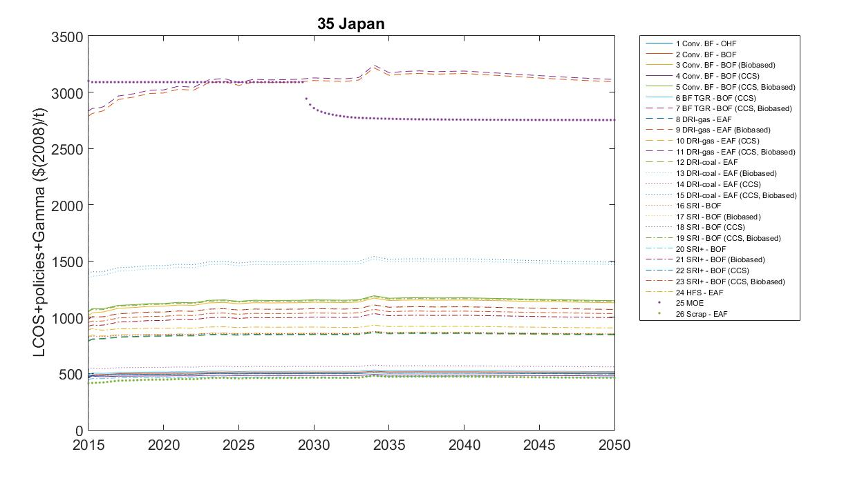
FTT:Steel – Examples of preliminary results
Development over time of the LCOS in Japan
Scrap-EAF always the cheapest technology, but increases slightly because of a decrease in scrap availability

Slide 23
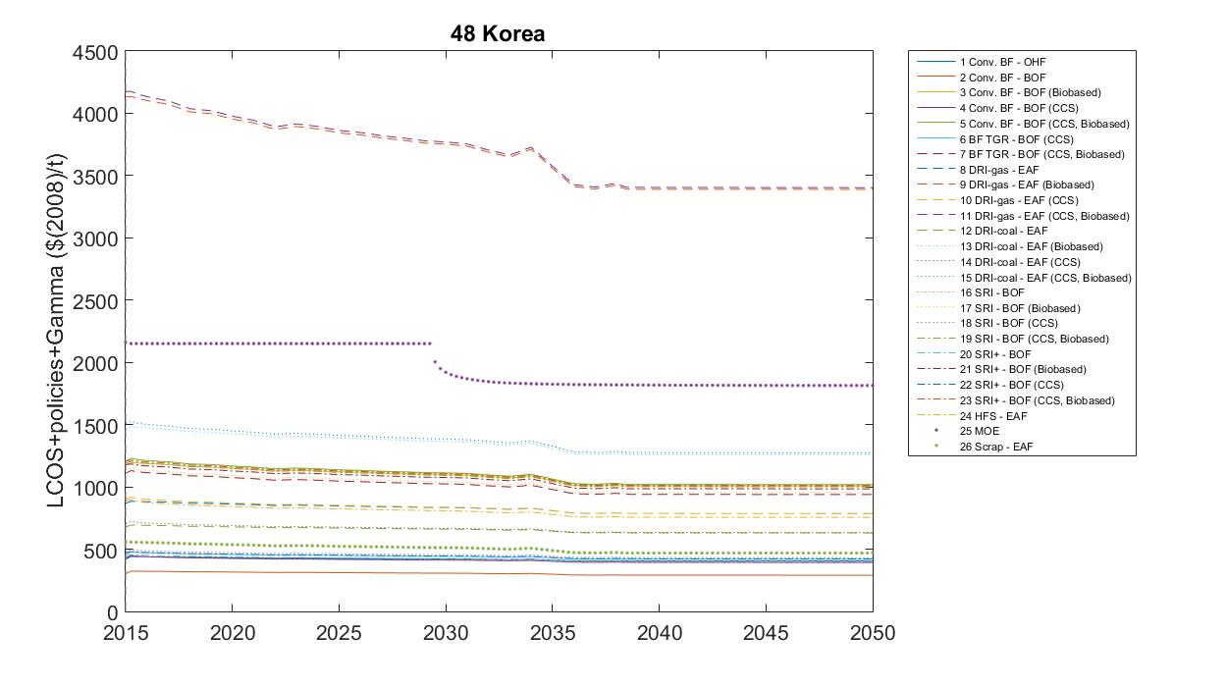
FTT:Steel – Examples of preliminary results
Development over time of the LCOS in Korea
Conv. BF-BOF is the cheapest technology. This is unlikely, so data optimisation is needed!
(Even Conv. BF-OHF is cheaper than most technologies!)

Slide 24
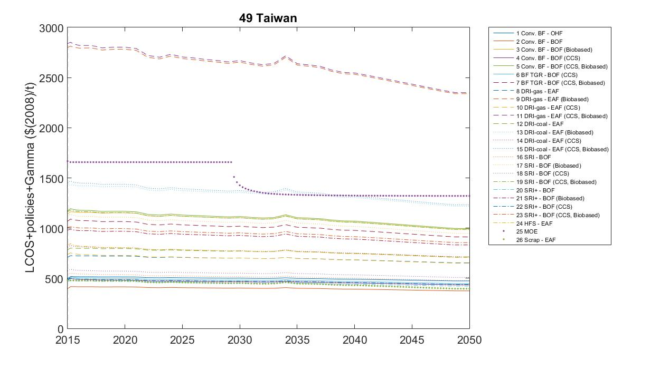
FTT:Steel – Examples of preliminary results
Development over time of the LCOS in Taiwan
Same story as Korea

Slide 25
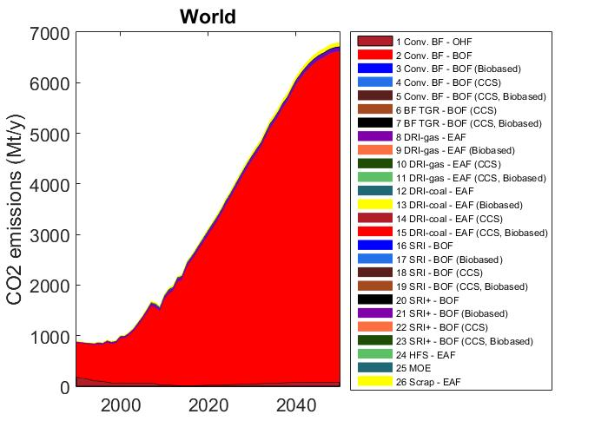
FTT:Steel – Preliminary results

Slide 26
FTT:Steel – Any recommendations?
If anyone has any recommendations, questions, or remarks regarding FTT:Steel please let me know

Slide 27
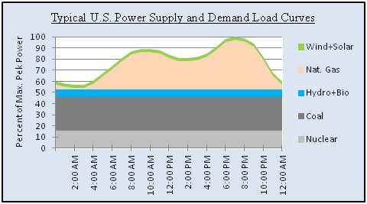
FTT:Power as an example – 1
A deep understanding of the power sector was required to set up the model
Many technologies exist, but they are not always easily interchangeble!
Baseload load technologies (Coal-, Nuclear-, Geothermal-based technologies, etc.)
Flexible load technologies (Oil-, Natural gas-, Hydro-based technologies, etc.)
Variable load technologies (Solar-, Wind-, Wave-based technologies, etc.)

Slide 28
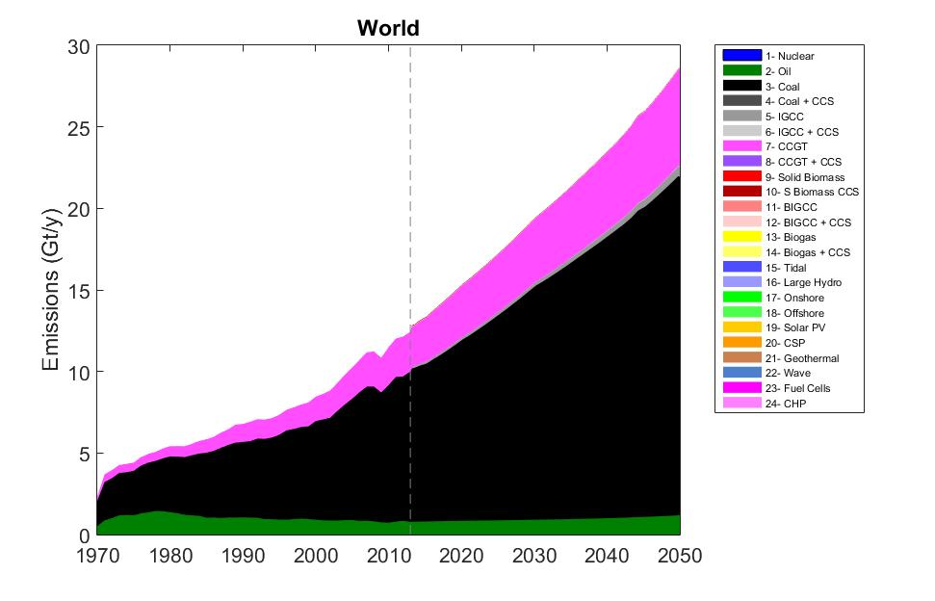
FTT:Power as an example – 2
Under the baseline scenario of FTT:Power, renewables do not gain a significant market share
Emissions will continue to rise
Policies are needed to incentivise renewables and perhaps to penalise fossil technologies

Slide 29
How to run FTT in MATLAB
Change the MATLAB working directory to the directory where you unzipped the files
Type “FTT59x24v7Gui” in the command line
This should open the Graphical User Interface
Click “Load History”
Select scenario and click “Calculate”

Slide 30
How to set policies
Sub: Subsidies on the capital cost of technologies (e.g. public-private partnerships). This is specified as a negative % of the capital cost
FiT: Feed-in tariffs are prices offered to producers for their electricity below market price. They are specified in $/MWh subtracted from the bare LCOE
Reg: Capacity cap in GW. When exceeded a phase-out is required.
DP: These are not quite policy instruments, but exogenous parameters, which can be related to policy. There are 4 of these:
MEDK: Electricity peak capacity demand to average capacity demand ratio (% = GWpeak/GWavg)
MEDD: Electricity peak demand to average demand ratio (% = GWh_peak/GWh_avg)
MEKS: Electricity storage generation capacity to total generation capacity (% = GWst/GWtot)
MEES: Electricity storage available to total electricity generation ratio (% = GWh_st/GWh_tot)
CO2P: Tax applied to emissions by electricity generators proportional to their emissions, in $/tCO2.
MWKA: Command and control government planning on electricity generation capacity, in which capacities are specified in GW per technology/country.

Slide 31
Generic assignment – Scenario 1
Scope : Japan (No. 35) and China (No. 41)
Goal : Expand the market share of CCS and biomass
Policies
Tax on investment costs:
25% for biomass techs (enter as: 0,25)
50% for CCS techs (enter as: 0,5)
Regulations:
Coal:
Japan: 85 GW in 2018 and a 2 GW annual decrease
China: 750 GW in 2018 and a 15 GW annual decrease
Evaluate Emissions, Electricity Price, Market shares of Coal and Renewables (only solar and wind)
Realize that changes occur due to technological diffusion which are driven by the LCOE

Slide 32
Generic assignment – Scenario 2
Scope : Japan (No. 35) and China (No. 41)
Goal : Incentivize renewables (…and cheat a little bit)
Policies
Subsidies on investment costs:
75% for all solar and wind technologies (enter: -0,75)
Electricity storage to capacity ratio (MEES and MEKS):
Japan: 1% in 2018. Let it increase by 2% annually until 50% is reached
China: 30% in 2018. Let it increase by 0,25% annually
Evaluate Emissions, Electricity Price, Market shares of Coal and Renewables (only solar and wind)
Realize that changes occur due to technological diffusion which are driven by the LCOE

Slide 33
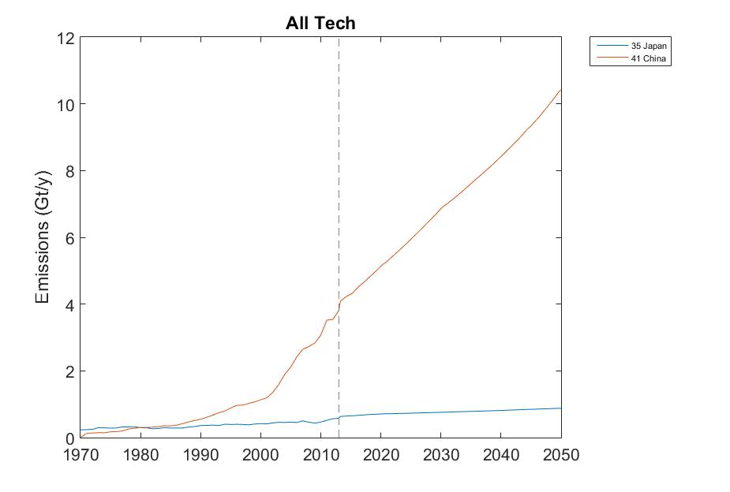
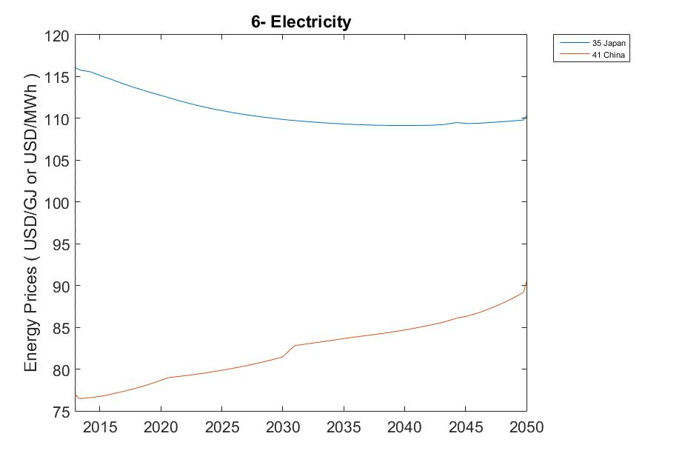
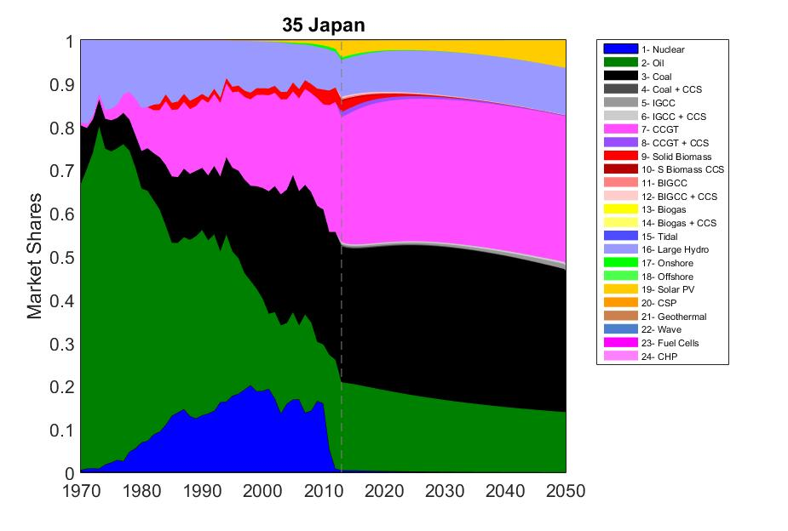
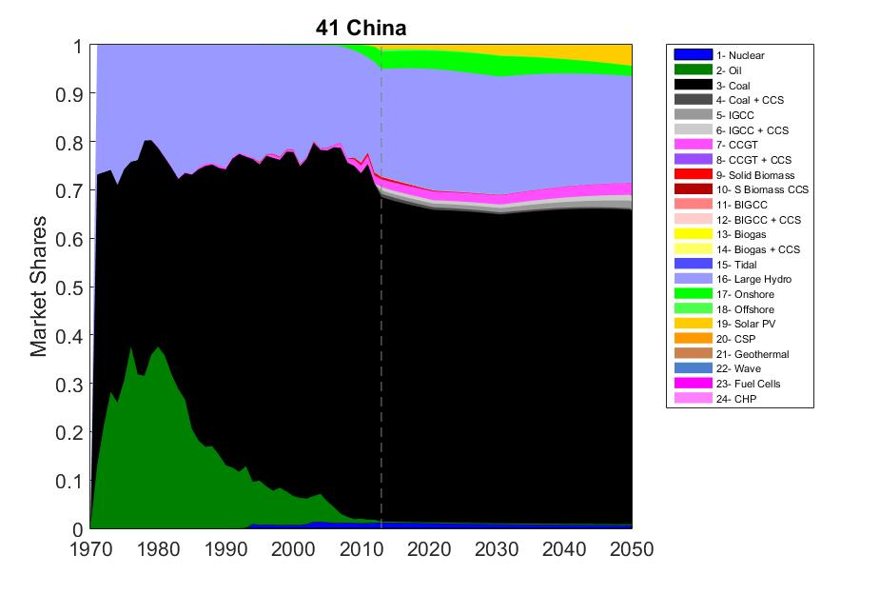
Generic assignments – Baseline

Slide 34
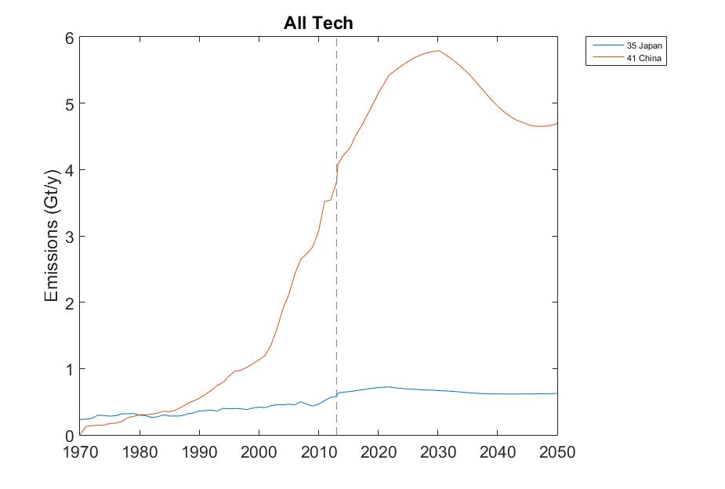
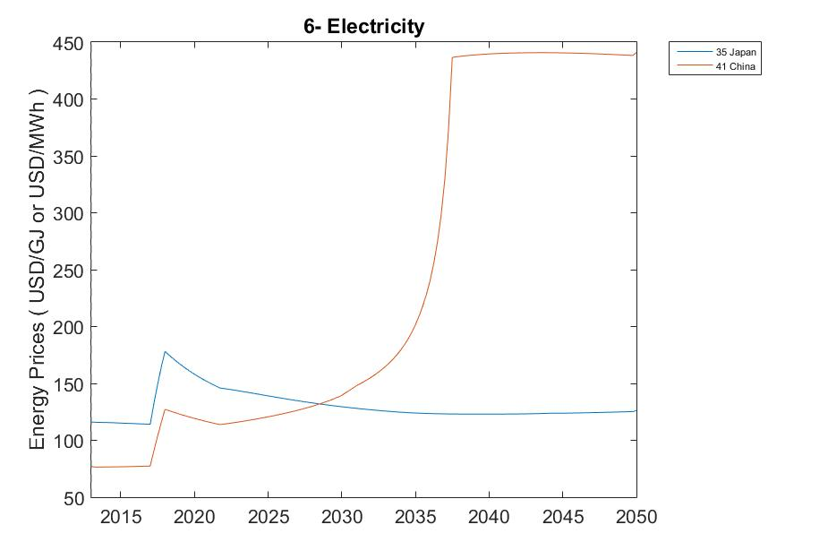
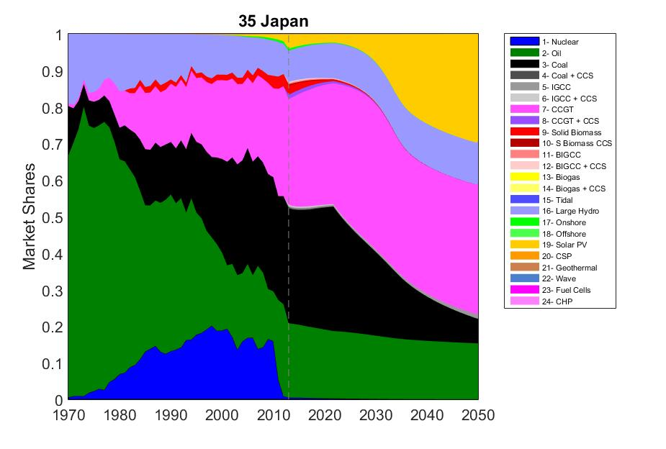
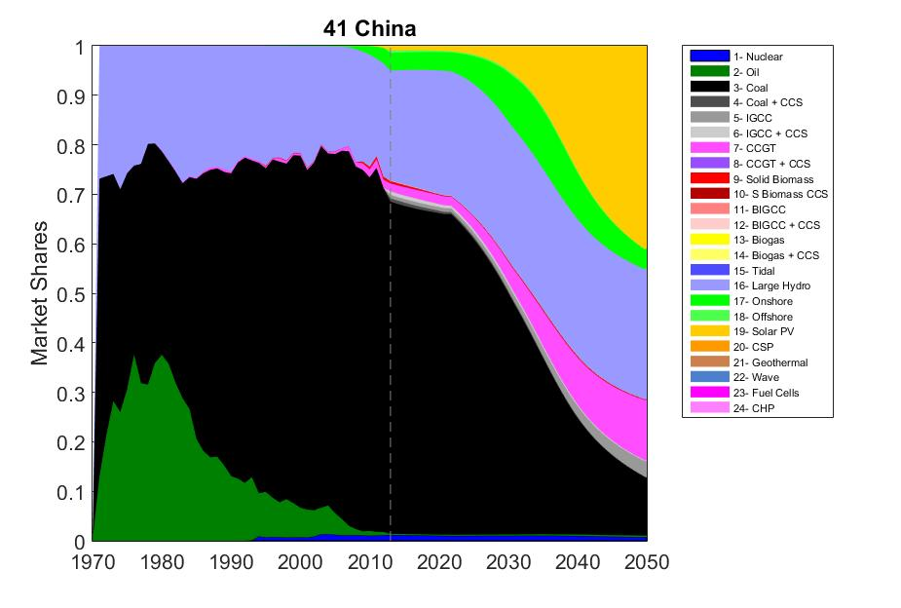
Generic assignment – Scenario 1 – Outcome of policy portfolio

Slide 35
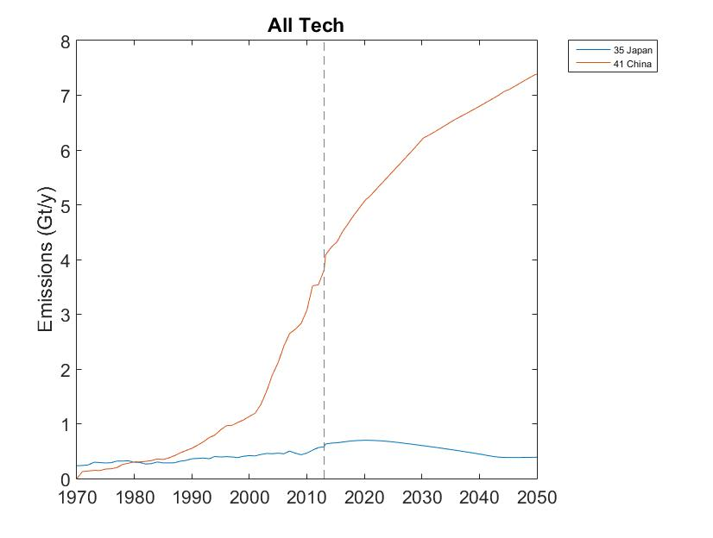
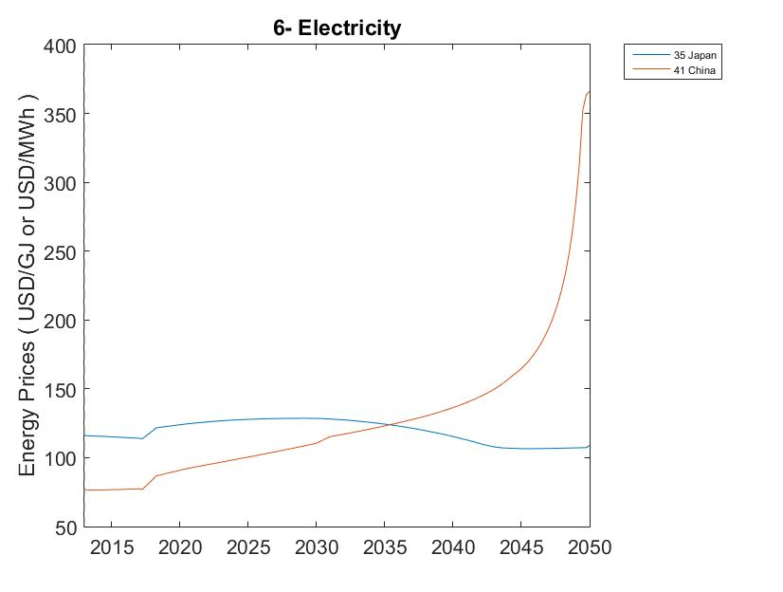
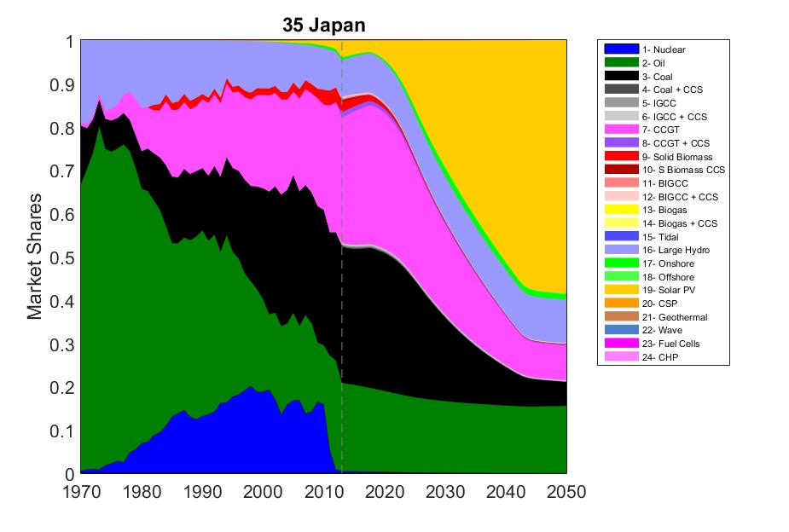
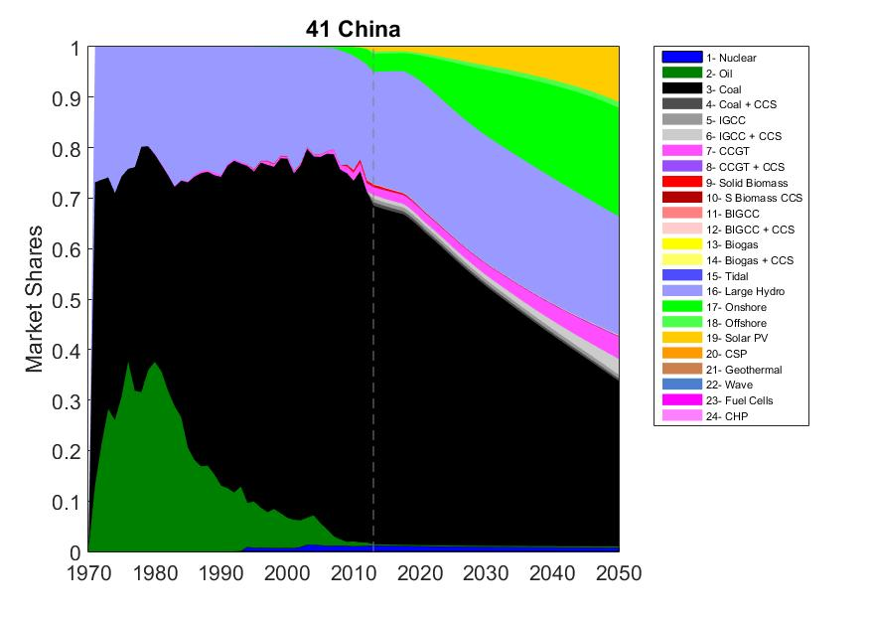
Generic assignment – Scenario 2 – Outcome of policy portfolio

Slide 36
Generic assignment - Summary
Country |  | Japan |  |  | China
Scenario |  | S0 | S1 | S2 | S0 | S1 | S2
Emissions (Gt/y) | 2018 | 0,686 | 0,687 | 0,6879 | 4,792 | 4,753 | 4,784
 | 2050 | 0,8762 | 0,6271 | 0,3914 | 10,42 | 4,704 | 7,383
Electricity Price $₁₃/MWh | 2018 | 113,7 | 178,1 | 121,6 | 77,74 | 127,2 | 86,79
 | 2050 | 110,3 | 126 | 108,7 | 90,5 | 438,2 | 366,3
Market share of Solar and Wind | 2018 | 2,8% | 2,9% | 3,1% | 4,8% | 4,9% | 4,9%
 | 2050 | 6,2% | 29,2% | 59,9% | 6,5% | 44,8% | 33,3%
Market share of coal (-) | 2018 | 32,5% | 32,5% | 32,3% | 65,4% | 65,4% | 65,3%
 | 2050 | 32,7% | 6,7% | 5,5% | 64,8% | 11,7% | 32,8%

Slide 37
Design your own policy portfolio
Scope : Japan (No. 35) and China (No. 41)
Goal : Decarbonize the power sectors of Japan and China by 50% by 2050 compared to 2013 ±0,29 Gt/y for Japan in 2050 ±1,6 Gt/y for China in 2050
Design your own policy portfolio

